Slide 1


An Experimental Evaluation of 3D Mapping with an Autonomous Helicopter
Brance Hudzietz
Mentored by Srikanth Saripalli
Arizona State University
School of Earth and Space Exploration
NASA Space Grant

Slide 2
Outline
3D Mapping and its Significance
Problems with Current Mapping Methods
Structure from Motion (SFM)
SFM Mapping with an Autonomous Helicopter
Flight Path Planning
Data, Results, and Conclusions
Future Work
Questions

Slide 3
3D Mapping
3D mapping is the process of creating a three dimensional model of a surface.
These models are useful for terrain analysis, geological surveying, tracking soil erosion, rock wall stability, etc.
Compare models over time to track geological changes
How are 3D maps created?

Slide 4
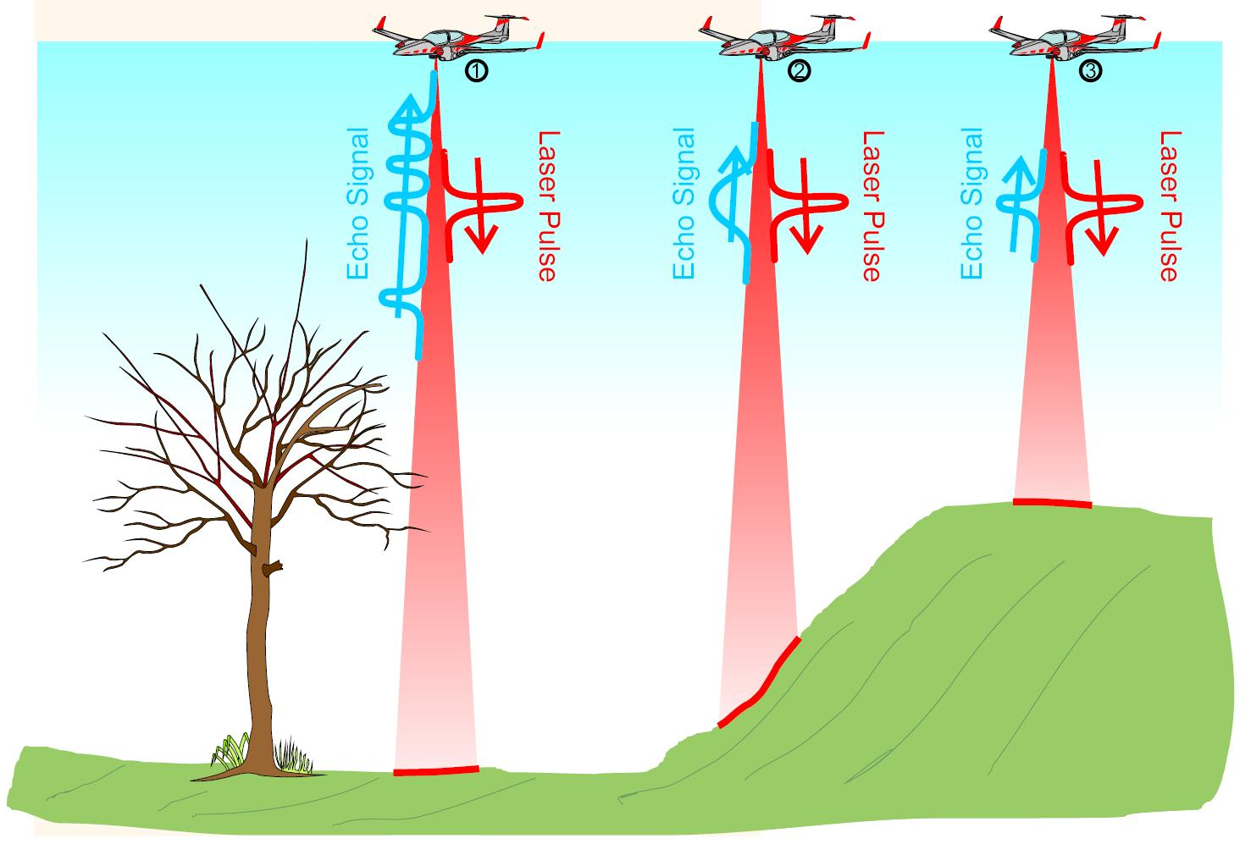
Current Large-Scale
Mapping Techniques
LiDAR
Light Detection and Ranging (LiDAR) devices provide high accuracy distance measurements
Manual Surveying
Total stations and differential GPS devices measure distances between points to a high accuracy
Picture courtesy of Riegl LiDAR

Slide 5
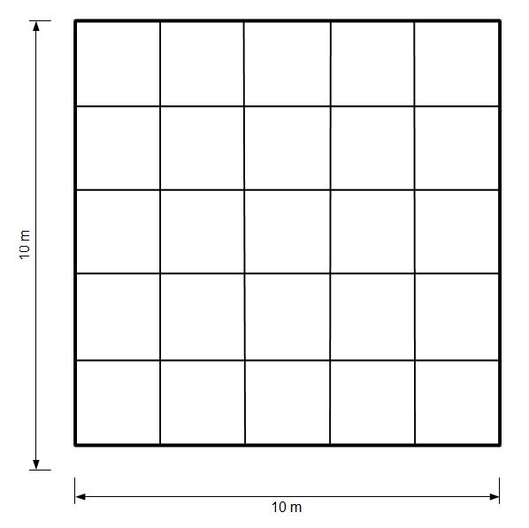
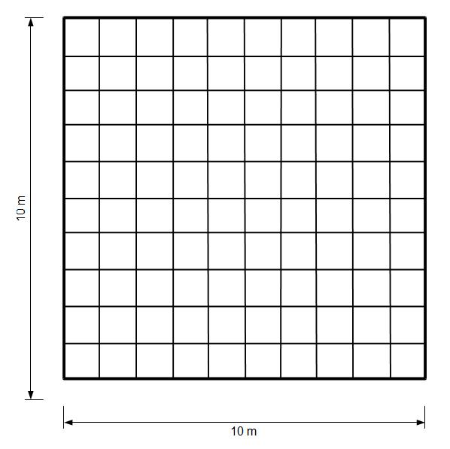
Problems with
Current Techniques
Manual Surveying
Requires multiple people
Resolution of map depends on data point grid size
LiDAR
Expensive
Large and Heavy
Doubling the resolution for manual surveying
→ Large increase in number of data points

Slide 6
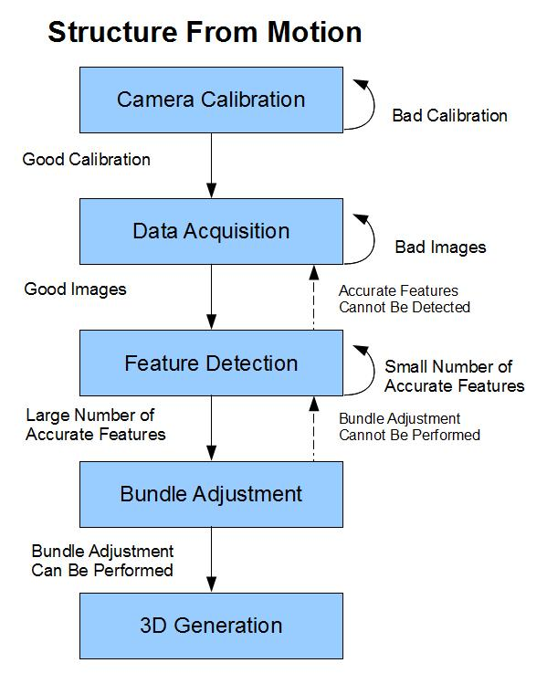
Structure From Motion
Calibrate Camera
Take two pictures which have some overlap
Find points which are in both images
Determine how much these points have moved and rotated between the images
Create a 3D model and 'drape' the images over the model

Slide 7
Structure From Motion
Suited for UAVs
Small, lightweight equipment
  LiDAR devices are large and heavy
  Stereo vision requires large baseline – impractical for UAVs
Low price
  LiDAR extremely expensive
Software Options
  Commercial
  Open Source

Slide 8
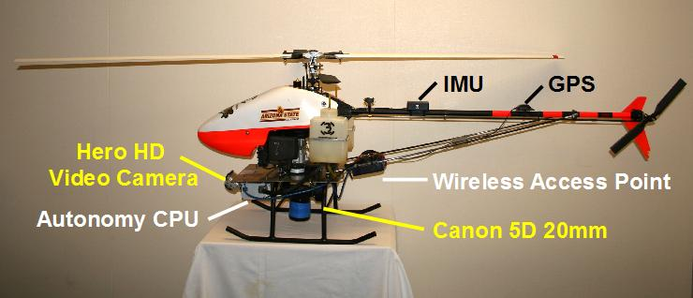
Integrating UAVs and
Structure From Motion
Orient camera perpendicular to imaging surface
Isolate camera from mechanical vibrations
Plan flight path and image capture locations

Slide 9
Flight Path Planning
Decompose mapping area into identical rectangles corresponding to image size
Generate the shortest path which visits the center of all rectangles
  i.e. Traveling Salesman Problem

Slide 10
Evaluating SFM Mapping
Ground based testing in man-made environments
  camera calibration, accuracy analysis
Ground based testing in natural environments
  establish that SFM process is working correctly
Airborne testing in natural environments
  evaluate UAV based SFM mapping

Slide 11
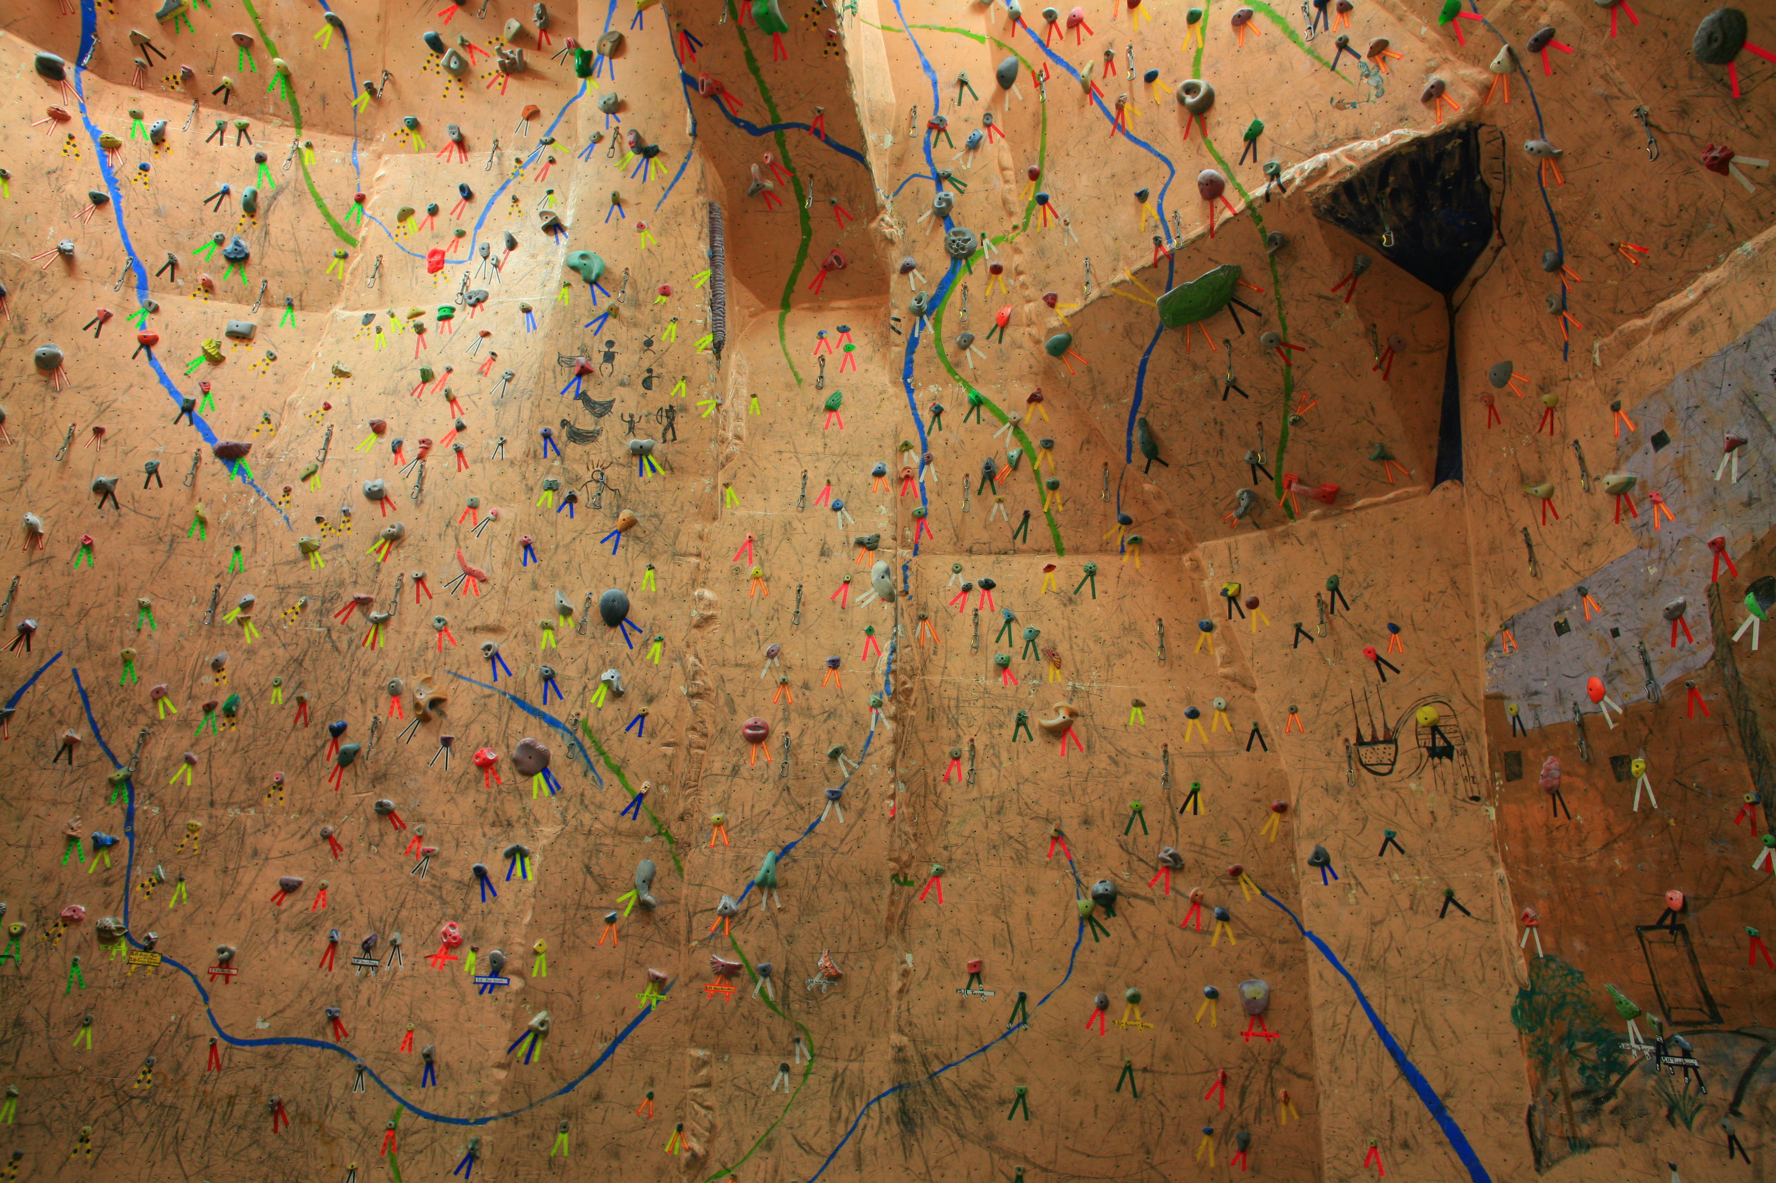
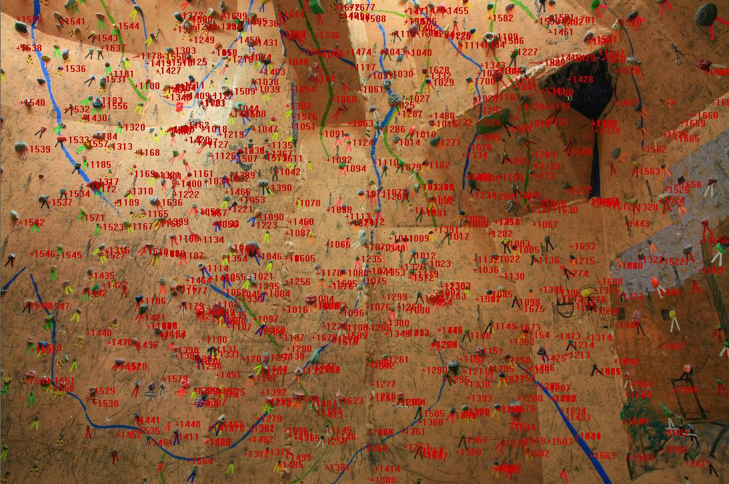
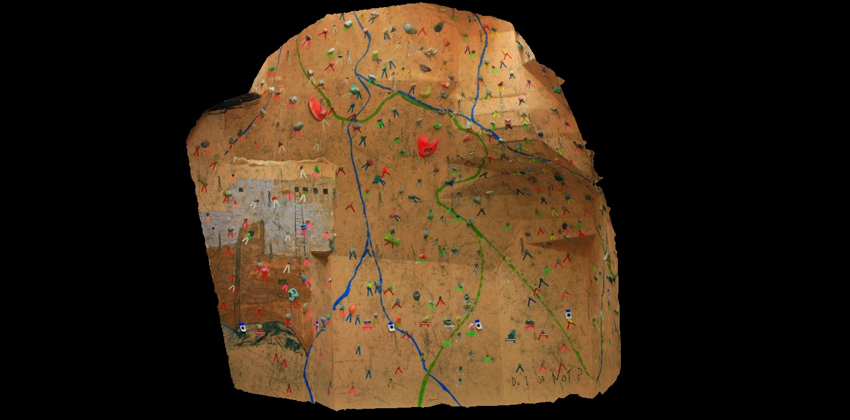
Ground Based Testing
in Man-Made Environments
1
2
1. Original picture taken at Phoenix Rock Gym
2. Original picture with common features identified
3. 3D model generated from pictures
3

Slide 12
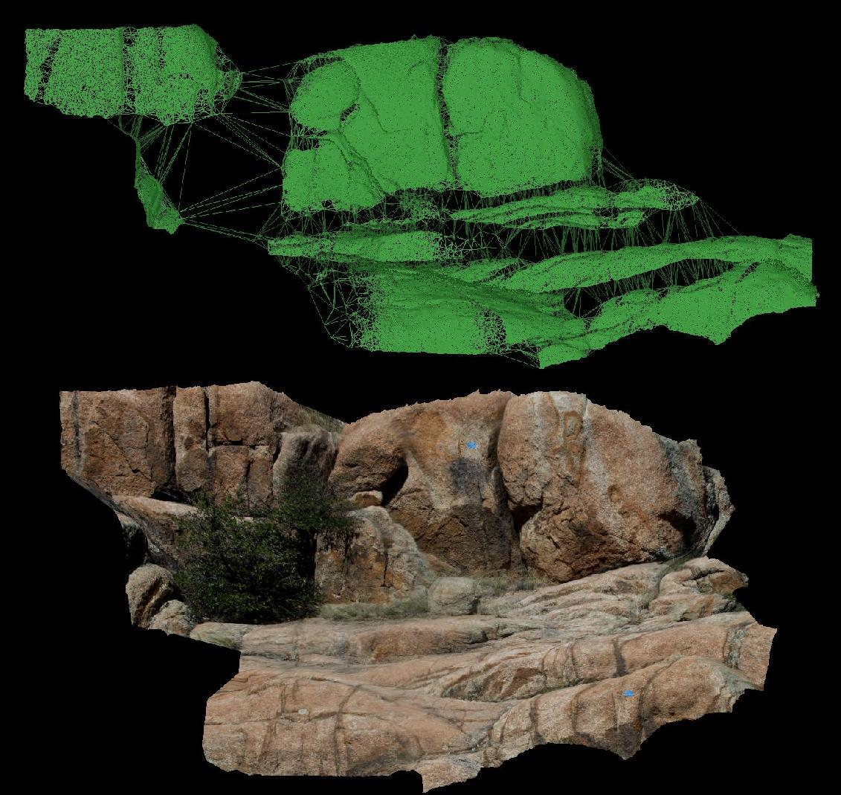
Ground Based Testing
in Natural Environments
3D wire-frame model
Same model with images draped

Slide 13
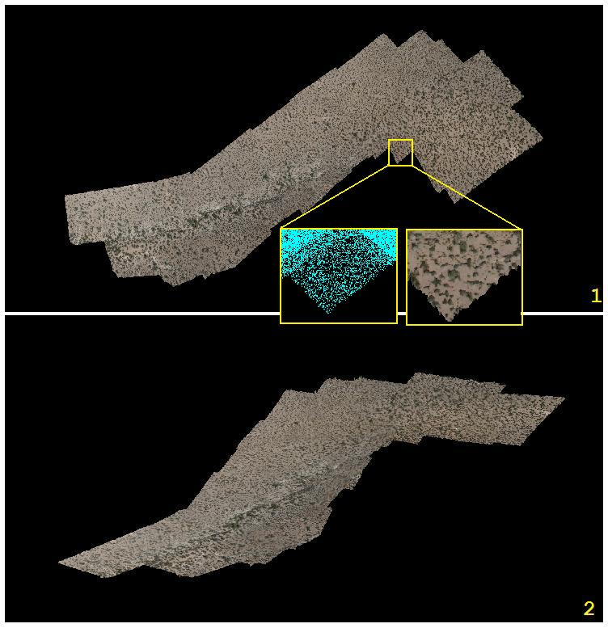
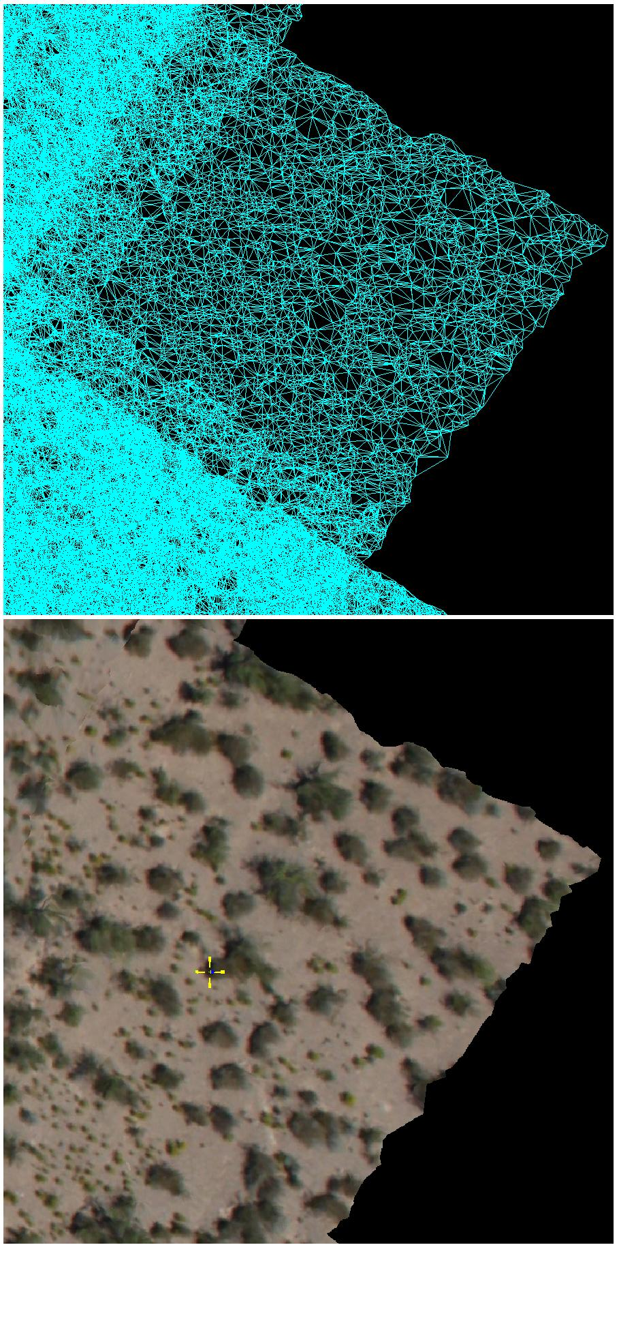
Airborne Testing
in Natural Environments
Las Cruces, New Mexico

Slide 14
Resolution and Accuracy
Resolution Estimate
Actual Error
Projected Error
Measurements from ground based testing in man-made environments
Max Error = 4.26cm
Standard Deviation = 1.50cm

Slide 15
Conclusions
Small, affordable equipment
→ viable integration with UAVs
High accuracy, high resolution models
Automated flight path generation
  → less preparation time for large flight areas
Large-scale terrain mapping available to more institutions

Slide 16
Future Work
Detailed accuracy analysis
  Compare our models with USGS models
Feature tracking combined with 3D mapping
  Identify moving objects (people, cars, etc.) which decrease map accuracy
Multi-vehicle based mapping
  Using multiple planes or helicopters can
  we create more accurate maps?
Improve path planning algorithm
  TSP solvers which weight turns – for fixed wing UAVs
  Include kinematic constraints in TSP solver

Slide 17
Thank You!
Questions
Brance.Hudzietz@asu.edu

